Slide 1
Module 26

Slide 2
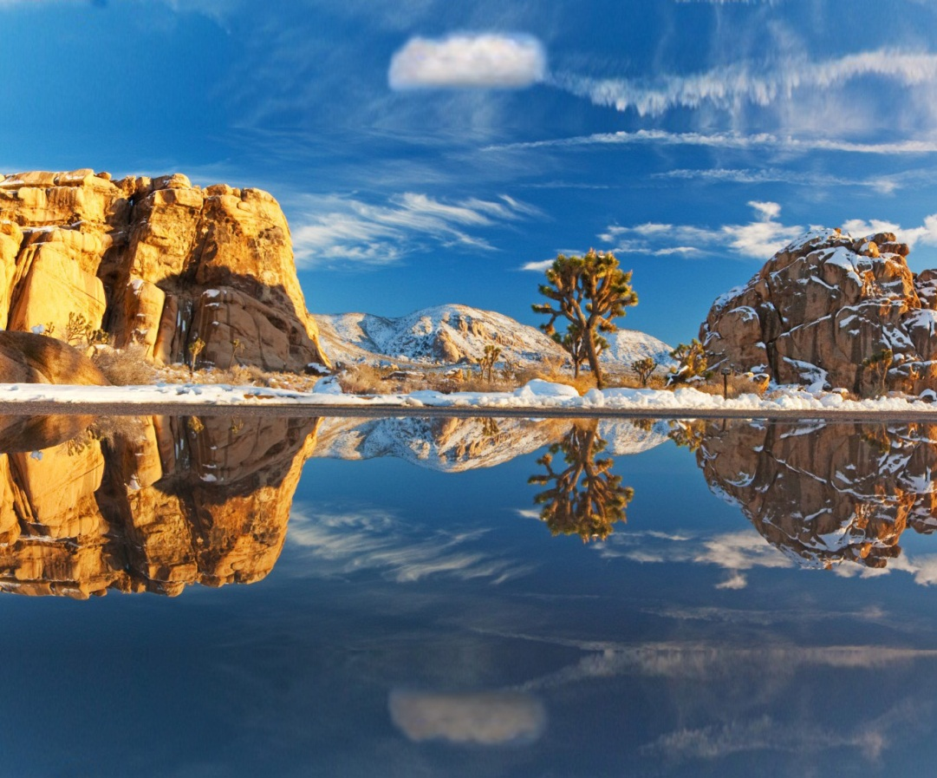


The angle of elevation of a cloud from a point 60m above a lake
is 30º and the angle of depression of the reflection of cloud in
the lake is 60º. Find the height of the cloud from lake surface.
P
Height of the person
is neglected
cloud
line of sight
Observer
A
30º
D
Horizontal line
60º
60m
Distance of
cloud from
lake surface
Distance of its reflection from lake surface
=
B
C
line of sight
reflection
Q

Slide 3
P
The angle of elevation of a cloud from
a point 60m above a lake is 30º and
the angle of depression of the reflection
of cloud in the lake is 60º. Find the height
of the cloud from lake surface.
Opposite
side
For ∠PAD
PC is made up of PD and CD
Ratio of opposite side and Adjacent side reminds us of _________
What does point ‘P’
represent?
Consider ΔADP
PD + CD = PC
∴ PD + 60 = x
∴ PD = (x - 60)m
Observe ∠A
Reflection
of the cloud
cloud
Observe PC
Opposite side →
PD
oABCD is a rectangle
What does point ‘A’
represent?
(x-60)
What does point ‘Q’
represent?
AB = CD = 60m
∴ CQ = x
Observer
Let PC = x
PC = CQ
Adjacent side →
AD
x
‘tan’
A
3
30º
(x – 60)
D
60º
Sol. :
A represents observer above the lake.
AB = 60 m
P represents the cloud.
∠PAD is the angle of elevation.
∠PAD = 30º
Q represents the reflection of cloud.
∠DAQ is the angle of depression.
∠DAQ = 60º
In right angled ΔADP,
tan 30º =
60m
60m
Adjacent side
B
C
1
tan 30º =
?
x
3
PD
AD
Q
∴
1
x – 60
=
3
AD
∴
AD
=
(x – 60)
m
3

Slide 4
P
The angle of elevation of a cloud from
a point 60m above a lake is 30º and
the angle of depression of the reflection
of cloud in the lake is 60º. Find the height
of the cloud from lake surface.
QD is made up of QC and CD
Observe ∠A
Ratio of opposite side and Adjacent side reminds us of _________
For ∠DAQ
Consider ΔAQD
QD = (x + 60)m
Observe QD
QD = CQ + CD
(x-60)
Opposite side →
DQ
Adjacent side
‘tan’
A
x
3
Adjacent side →
AD
30º
(x – 60)
D
60º
Sol. :
In right angled ΔAQD,
60m
60m
tan 60º =
DQ
AD
B
(x + 60)
C
x + 60
∴
3
=
Opposite
side
3
(x – 60)
tan 60º =
?
3
∴
3 (x – 60) =
x + 60
x
∴
3x – 180 =
x + 60
∴
3x – x =
60 + 180
∴
2x =
240
Q
∴
x = 120
∴
PC =
120 m
∴
The height of cloud above the lake is 120 m

Slide 5
Module 27

Slide 6
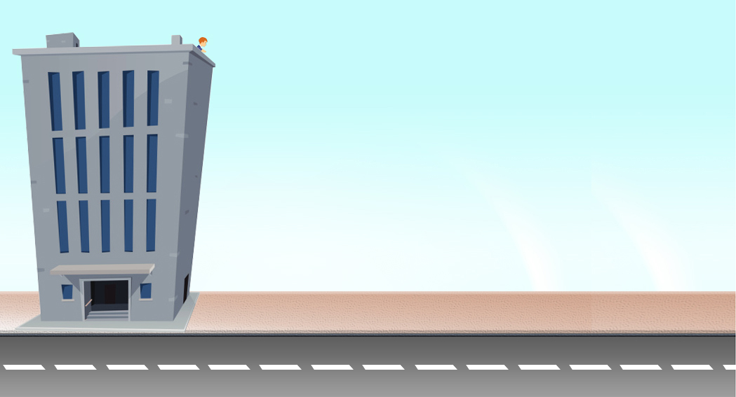
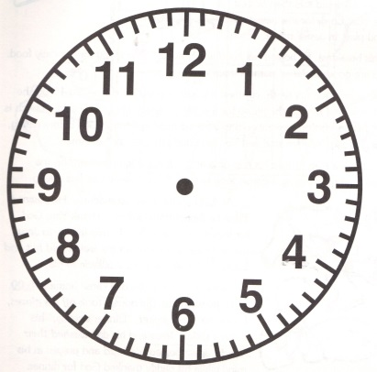

Q. A straight highway leads to the foot of tower. A man standing at the
top of tower observes a car at an angle of depression of 30º,
which is approaching the foot of the tower with uniform speed.
Six seconds later, the angle of depression of the car is found to be 60º.
Find the time taken by the car to reach the foot of the tower from this point.
Observer
E
Horizontal line
B
30º
60º
What can we say about these two angles ?
∠EBC and ∠BCA are what type of angles?
∠EBD and ∠BDA are what type of angles?
They are equal
What can we say about these two angles ?
Observe
∠EBD and ∠BDA
Observe
∠EBC and ∠BCA
They are equal
Alternate angles
Alternate angles
line of sight
Distance
Time =
Speed
line of sight
Foot of the Tower
? sec
60º
6 sec
30º
A
C
D

Slide 7








Q. A straight highway leads to the foot of tower.
A man standing at the top of tower observes
a car at an angle of depression of 30º,
which is approaching the foot of the tower
with uniform speed. Six seconds later,
the angle of depression of the car is found
to be 60º. Find the time taken by the car to
reach the foot of the tower from this point.
B
Opposite
side
Observe ∠C
Opposite
side
30º
E
Ratio of opposite side and Adjacent side reminds us of _________
Ratio of opposite side and Adjacent side reminds us of _________
For ∠BCA
Consider ΔBAC
60º
For ∠BDA
Consider ΔABD
Observe ∠D
Opposite side →
AB
h
Opposite side →
AB
‘tan’
‘tan’
Adjacent side →
AC
Adjacent side →
AD
? sec
6 sec
60º
30º
A
D
(y) m
C
(x) m
Sol.
Let the height of tower (AB) be ‘h’ m
(x + y) m
Adjacent side
Let the distance of the foot of tower
to the car at C(AC) be ‘y’ m
Adjacent side
1
tan 30º =
?
Let the distance covered by the car in
6 seconds (CD) be ‘x’ m
$$\sqrt{3}$$
$$\sqrt{3}$$
tan 60º =
?
In right ΔBAC,
In right ΔBAD,
∴
x + y
=
h$\sqrt{3}$
AB
AB
[From (i)]
tan 60º =
tan 30º =
∴
x + y
=
$\sqrt{3}$y
× $\sqrt{3}$
AC
AD
h
1
h
∴
x + y
=
3y
∴
$\sqrt{3}$ =
∴
=
y
$$\sqrt{3}$$
x + y
∴
x
=
2y
…(ii)
∴
h =
$\sqrt{3}$y
…(i)

Slide 8
Q. A straight highway leads to the foot of tower.
A man standing at the top of tower observes
a car at an angle of depression of 30º,
which is approaching the foot of the tower
with uniform speed. Six seconds later,
the angle of depression of the car is found
to be 60º. Find the time taken by the car to
reach the foot of the tower from this point.
B
30º
E
60º
h
? sec
6 sec
A
60º
30º
(y) m
C
(x) m
D
Sol.
Distance covered by car in
6 seconds = x m
x
=
2y
…(ii)
Distance
∴
Speed of the car
=
Time
∴
Time taken by car to reach the
foot of tower from point C,
x
=
6
Distance
2y
Time
=
=
[From (ii)]
Speed
6
3
y
∴
Speed of the car
=
m/sec
3

Slide 9
Q. A straight highway leads to the foot of tower.
A man standing at the top of tower observes
a car at an angle of depression of 30º,
which is approaching the foot of the tower
with uniform speed. Six seconds later,
the angle of depression of the car is found
to be 60º. Find the time taken by the car to
reach the foot of the tower from this point.
B
30º
E
60º
h
? sec
6 sec
A
60º
30º
(y) m
C
(x) m
D
Sol.
Time taken by car to reach the foot of tower from point C,
y
Distance
Speed of the car
=
m/sec
Time
=
3
Speed
y
=
y
3
3
=
y ×
=
3 sec.
y
Time taken by the car to reach the foot of
tower from this point is 3 sec.

Slide 10
Module 28

Slide 11
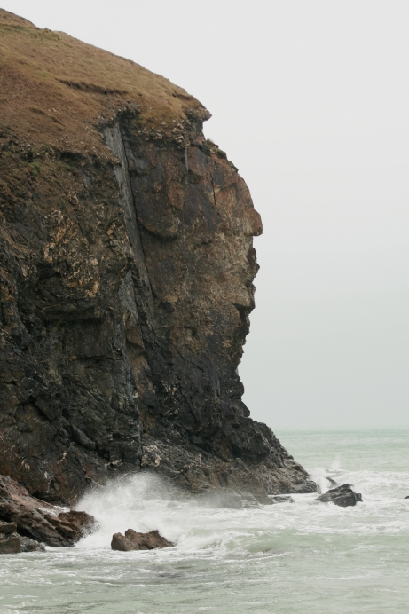

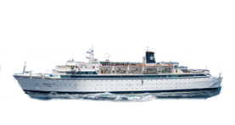
Q. A man on cliff observes a boat at an angle of depression 30º, which is sailing
towards the point of the shore immediately beneath him. Three minutes later
the angle of depression of boat is found to be 60º. Assuming that the boat
sails at uniform speed, determine how much more time it will take to reach
the shore.
Height of the person
is neglected
E
A
Horizontal line
30º
60º
Observe
∠EAD and ∠ADB
What can we say about these two angles ?
∠EAC and ∠ACB are what type of angles?
∠EAD and ∠ADB are what type of angles?
What can we say about these two angles ?
Observe
∠EAC and ∠ACB
They are equal
They are equal
Alternate angles
Alternate angles
Time =
Line of sight
Line of sight
60º
Time = ?
30º
B
C
D

Slide 12
Q. A man on cliff observes a boat at an angle of depression 30º, which is sailing
towards the point of the shore immediately beneath him. Three minutes later
the angle of depression of boat is found to be 60º. Assuming that the boat
sails at uniform speed, determine how much more time it will take to reach
the shore.
A
Sol.
D and C are the initial and final
positions of the ship.
30º
E
60º
A represents the position of observer.
∠EAD and ∠EAC are the angles
of depression.
60º
30º
B
C
D
∠EAD = 30º,
∠EAC = 60º,
Final position
Initial position
∠EAD = ∠ADB = 30º
[Alternate angles]
∠EAC = ∠ACB = 60º
The ship took 3 mins to travel from D to C

Slide 13



Q. A man on cliff observes a boat at an angle of depression 30º, which is sailing
towards the point of the shore immediately beneath him. Three minutes later
the angle of depression of boat is found to be 60º. Assuming that the boat
sails at uniform speed, determine how much more time it will take to reach
the shore.
For ∠ACB
Ratio of opposite side and Adjacent side reminds us of _________
BC belongs to ΔABC
Consider ΔABC
Observe ∠C
Opposite side →
AB
‘tan’
Adjacent side →
BC
A
Sol.
30º
E
Opposite
side
60º
Let the uniform speed be x
Time taken from C to D = 3 minutes
∴ Distance from C to D = Speed x Time
∴ CD = x × 3
60º
30º
∴ CD = 3x units
B
C
D
tan 60º =
$$\sqrt{3}$$
3x
?
In right angled ΔABC,
Distance
Adjacent side
Time =
AB
speed
tan 60º =
BC
BC
?
=
AB
x
∴
$\sqrt{3}$ =
BC
∴
AB =
$\sqrt{3}$ BC

Slide 14






Q. A man on cliff observes a boat at an angle of depression 30º, which is sailing
towards the point of the shore immediately beneath him. Three minutes later
the angle of depression of boat is found to be 60º. Assuming that the boat
sails at uniform speed, determine how much more time it will take to reach
the shore.
For ∠ADB
Observe ∠D
Ratio of opposite side and Adjacent side reminds us of _________
Consider ΔABD
BD is made up of
BC and CD
Opposite side →
AB
1
‘tan’
tan 30º =
?
Adjacent side →
BD
3
A
Sol.
In right angled ΔABD,
30º
E
60º
Opposite
side
AB
tan 30º =
BD
AB =
$\sqrt{3}$ BC
∴
1
AB
=
?
$$\sqrt{3}$$
BD
BC
60º
30º
Time =
BD
x
B
C
D
∴
AB =
3x
$$\sqrt{3}$$
Adjacent side
Distance
BD
BC
∴
$\sqrt{3}$ BC =
Time =
=
x
CD
speed
$$\sqrt{3}$$
∴ BC =
2
1.5 x
∴ 3BC = BD
3x
=
= 1.5 min
∴ BC =
x
∴ 3BC =
BC + CD
2
The time taken to reach
the shore is 1.5 min
∴ 2BC = CD
∴ BC = 1.5x units

Slide 15
Module 29

Slide 16
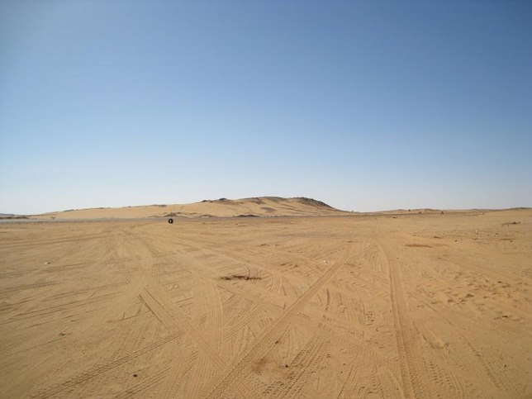

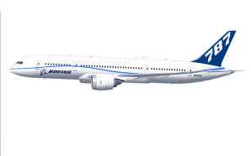

Q. The angle of elevation of a jet plane from a point A on the ground is 60º.
After a flight of 30 seconds, the angle of elevation changes to 30º.
If the jet plane is flying at a constant height of 3600
3 meter,
Find the speed of the jet plane
( 3 = 1.732)
Speed =
Distance
Height of the person is neglected
Time
P
Q
line of sight
line of sight
3600
3
m
3600
3
m
60º
30º
Horizontal line
A
S
R

Slide 17

Q. The angle of elevation of a jet plane from a point A on the ground is 60º.
After a flight of 30 seconds, the angle of elevation changes to 30º.
If the jet plane is flying at a constant height of 3600
For ∠PAS
Ratio of opposite side and Adjacent side reminds us of _________
AS + SR = AR
Observe ∠A
AS belongs to ΔPSA
SR is part of AR
Opposite side →
PS
3 meter,
∴ SR = AR – AS
‘tan’
Adjacent side →
( 3 = 1.732)
Find the speed of the jet plane
AS
1st position
?
2nd position
Sol.
Let P and Q be the first and second position
of a jet plane.
P
Q
Opposite
side
A represents the point on the ground.
∠PAS and ∠QAR are the angles of elevation.
3600
3
m
3600
3
m
∠PAS = 60º,
∠QAR = 30º
60º
PS and QR represents constant height at
which the jet plane is flying.
30º
R
A
S
?
3600 m
PQ or SR
Adjacent side
$$\sqrt{3}$$
SR = AR – AS
tan 60º =
?
PS = QR = 3600
3 m
In right angled ΔPSA,
Distance
Speed =
3600
3
PS
Time
tan 60º =
∴
AS
=
AS
3
3600
3
∴
AS =
3600 m
∴
3
=
AS

Slide 18

Q. The angle of elevation of a jet plane from a point A on the ground is 60º.
After a flight of 30 seconds, the angle of elevation changes to 30º.
If the jet plane is flying at a constant height of 3600
Find the speed of the jet plane.
For ∠QAR
Observe ∠QAR
Ratio of opposite side and Adjacent side reminds us of _________
AR is made up of
AS and SR
AR belongs ΔQRA
3 meter,
Opposite side →
QR
1
tan 30º =
?
‘tan’
P
Q
Adjacent side →
( 3 = 1.732)
$$\sqrt{3}$$
AR
7200m
Sol.
In right angled ΔQRA,
AS =
3600 m
Opposite
side
QR
tan 30º
=
3600
3
m
3600
3
m
AR
SR = AR – AS
3600
60º
∴
1
3
30º
=
A
S
R
3
AR
3600 m
7200m
x
oPQRS is a rectangle.
10800 m
∴
AR
=
3
3
Adjacent side
3600
PQ
=
SR
=
∴
AR
=
3600
× 3
7200m
∴
AR
=
10800 m
Distance covered
in 30 sec. =
7200m
AS
+
SR
=
AR
Distance
∴
3600
+
SR
=
10800
Speed =
Time
∴
SR
=
10800
–
3600
PQ
=
∴
SR
=
7200 m
30 sec.

Slide 19
Q. The angle of elevation of a jet plane from a point A on the ground is 60º.
After a flight of 30 seconds, the angle of elevation changes to 30º.
If the jet plane is flying at a constant height of 3600
Find the speed of the jet plane.
3 meter,
3 meter,
3 = 1.732 )
P
Q
(
7200m
Sol.
PQ
1 hr. = 3600 sec.
Speed
1 km = 1000 m
=
30 sec.
3600
3
m
3600
3
m
7200 m
=
60º
30 sec.
30º
R
A
S
7200m
3600 m
7200
÷
30
10800 m
=
km/hr.
1000
3600
120
7200
x
3600
=
=
72 × 12
1000
30
=
864
km/hr.
The speed of the jet plane is 864 km/hr.

Slide 20
Thank You

